Slide 1
DEVELOPMENT AND INHERITANCE
DEVELOPMENT AND INHERITANCE

Slide 2
THIRD WEEK OF DEVELOPMENT
THIRD WEEK OF DEVELOPMENT

Slide 3
THIRD WEEK OF DEVELOPMENT
Begins a six-week period of very rapid development and differentiation.
The three primary germ layers are established and lay the groundwork for organ development in weeks four through eight.

Slide 4
GASTRULATION
The bilaminar (two-layered) embryonic disc, consisting of epiblast and hypoblast is transformed into a trilaminar (three-layered) embryonic disc consisting of three primary germ layers: the ectoderm, mesoderm, and endoderm.
Occurs about 15 days after fertilization.
Involves the rearrangement and migration of cells from the epiblast.

Slide 5
GASTRULATION
Primitive streak- this is a faint groove on the dorsal surface of the epiblast that elongates from the posterior to the anterior part of the embryo.
It establishes the head and tail ends of the embryo.
It establishes right and left sides of the body.
At the head end of the primitive streak a small group of epiblastic cells forms a rounded structure called the primitive node.

Slide 6
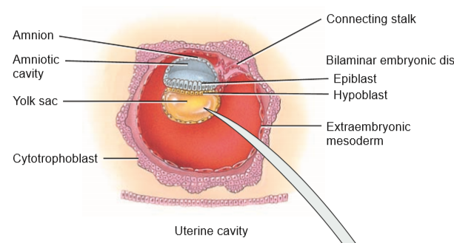
GASTRULATION INVOLVES THE REARRANGEMENT AND MIGRATION OF CELLS FROM THE EPIBLAST.

Slide 7
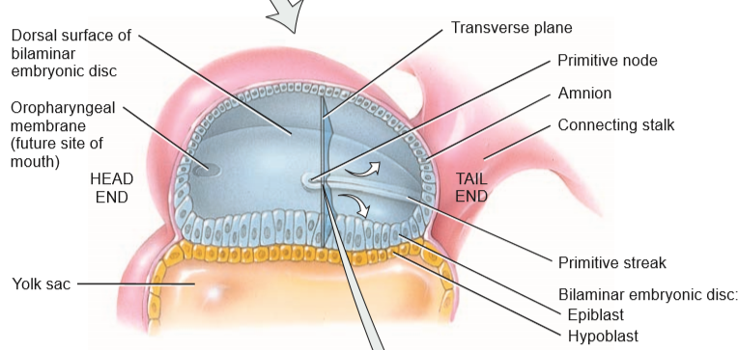
DORSAL AND PARTIAL SECTIONAL VIEWS OF EMBRYONIC DISC, ABOUT 15 DAYS AFTER FERTILIZATION

Slide 8
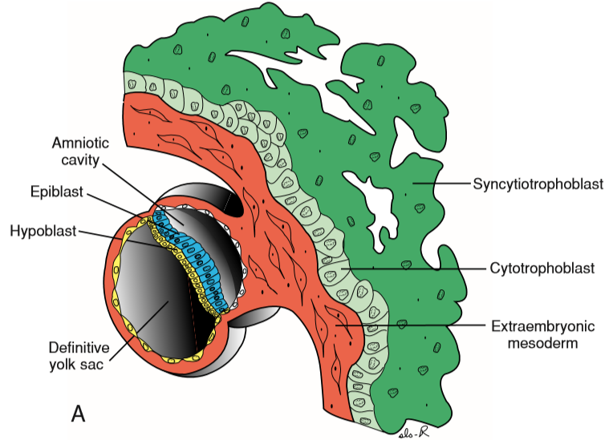

Slide 9
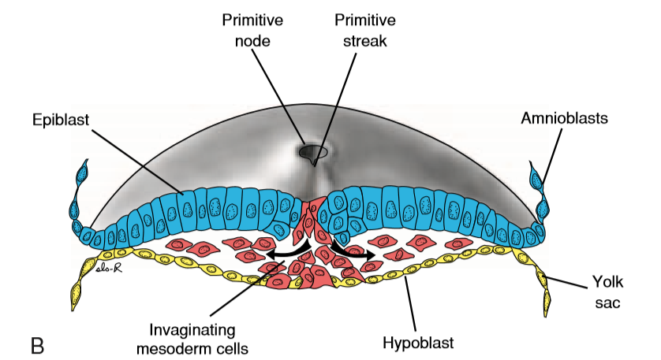

Slide 10
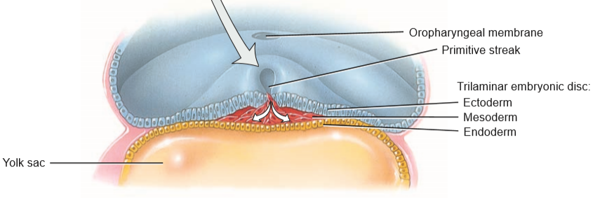
TRANSVERSE SECTION OF TRILAMINAR EMBRYONIC DISC,ABOUT 16 DAYS AFTER FERTILIZATION

Slide 11
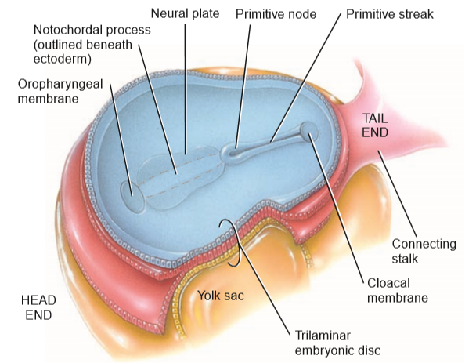
DORSAL AND PARTIAL SECTIONAL VIEWS OF TRILAMINAR EMBRYONIC DISC,ABOUT 16 DAYS AFTER FERTILIZATION.

Slide 12
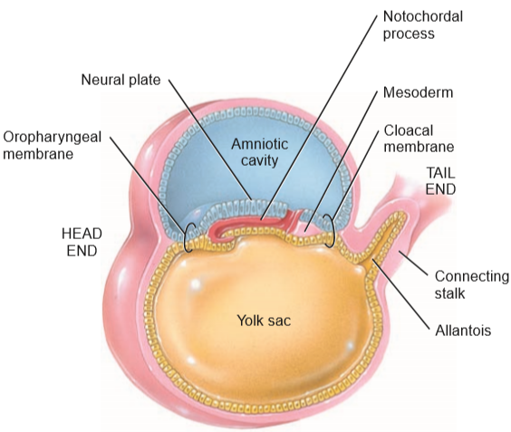
SAGITTAL SECTION OF TRILAMINAR EMBRYONIC DISC,ABOUT 16 DAYS AFTER FERTILIZATION

Slide 13
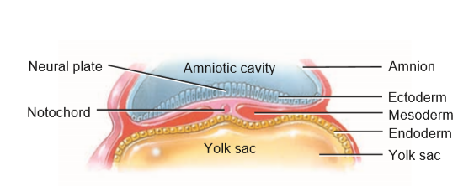
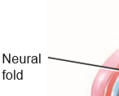
NEURULATION AND THE DEVELOPMENT OF SOMITES- TRANSVERSE SECTIONS

Slide 14
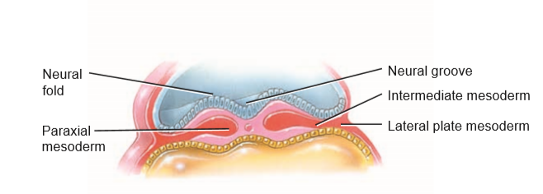
NEURULATION AND THE DEVELOPMENT OF SOMITES-TRANSVERSE SECTIONS

Slide 15
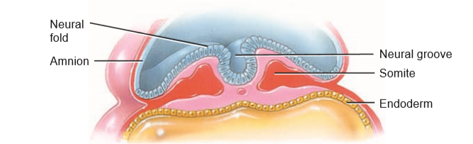
NEURULATION AND THE DEVELOPMENT OF SOMITES-TRANSVERSE SECTIONS

Slide 16
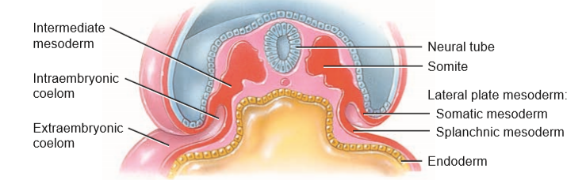
NEURULATION AND THE DEVELOPMENT OF SOMITES.

Slide 17
GASTRULATION
Invagination- process by which cells of the epiblast move inward below the primitive streak and detach from the epiblast.
Some of them displace the hypoblast, forming the endoderm.
Other cells remain between the epiblast and newly formed endoderm to form the mesoderm.

Slide 18
GASTRULATION
Cells remaining in the epiblast then form the ectoderm.
The ectoderm and endoderm are epithelia composed of tightly packed cells.
The mesoderm is a loosely organized connective tissue (mesenchyme).
The endoderm ultimately becomes the epithelial lining of the GIT, resp tract, and several other organs.

Slide 19
GASTRULATION
The mesoderm gives rise to muscles, bones, and other connective tissues, and the peritoneum.
The ectoderm develops into the epidermis of the skin and the nervous system.
About 16 days after fertilization, mesodermal cells from the primitive node migrate toward the head end of the embryo and form a hollow tube of cells in the midline called the notochordal process

Slide 20
GASTRULATION
By days 22–24, the notochordal process becomes a solid cylinder of cells called the notochord.
Notochord plays an extremely important role in induction.
Induction-the process by which one tissue (inducing tissue) stimulates the development of an adjacent unspecialized tissue (responding tissue) into a specialized one.

Slide 21
GASTRULATION
An inducing tissue usually produces a chemical substance that inﬂuences the responding tissue.
The notochord induces certain mesodermal cells to develop into the vertebral bodies.
It also forms the nucleus pulposus of the intervertebral discs.

Slide 22
GASTRULATION
Two faint depressions appear on the dorsal surface of the embryo.
The structure closer to the head end is called the oropharyngeal membrane.
It breaks down during the fourth week to connect the mouth cavity to the pharynx and the remainder of the gastrointestinal tract.

Slide 23
GASTRULATION
The structure closer to the tail end is called the cloacal membrane which degenerates in the seventh week to form the openings of the anus and urinary and reproductive tracts.
When the cloacal membrane appears, the wall of the yolk sac forms a small vascularized outpouching called the allantois that extends into the connecting stalk.

Slide 24
GASTRULATION
Allantois does function in the early formation of blood and blood vessels, and it is associated with the development of the urinary bladder.

Slide 25
STRUCTURES PRODUCED BY THE THREE PRIMARY GERM LAYERS.
STRUCTURES PRODUCED BY THE THREE PRIMARY GERM LAYERS.

Slide 26
ENDODERM
Epithelial lining of gastrointestinal tract (except the oral cavity and anal canal) and the epithelium of its glands.
Epithelial lining of urinary bladder, gallbladder, and liver.
Epithelial lining of pharynx, auditory (eustachian) tubes, tonsils, larynx, trachea, bronchi, and lungs.

Slide 27
ENDODERM
Epithelial lining of prostate and bulbourethral (Cowper’s) glands, vagina, vestibule, urethra, and associated glands such as the greater (Bartholin’s) vestibular and lesser vestibular glands.

Slide 28
MESODERM
All skeletal and cardiac muscle tissue and most smooth muscle tissue.
Cartilage, bone, and other connective tissues.
Blood, red bone marrow, and lymphatic tissue.
Endothelium of blood vessels and lymphatic vessels.
Dermis of skin.
Fibrous tunic and vascular tunic of eye.

Slide 29
MESODERM
Middle ear.
Mesothelium of thoracic, abdominal, and pelvic cavities.
Epithelium of kidneys and ureters.
Epithelium of adrenal cortex.
Epithelium of gonads and genital ducts

Slide 30
ECTODERM
All nervous tissue.
Epidermis of skin.
Hair follicles, arrector pili muscles, nails, epithelium of skin glands (sebaceous and sudoriferous), and mammary glands.
Lens, cornea, and internal eye muscles.
Internal and external ear.

Slide 31
ECTODERM
Neuroepithelium of sense organs.
Epithelium of oral cavity, nasal cavity, paranasal sinuses, salivary glands, and anal canal.
Epithelium of pineal gland, pituitary gland, and adrenal medullae

Slide 32
ESTABLISHMENT OF THE BODY AXES
Establishment of the body axes, anteroposterior, dorsoventral, and left-right, takes place before and during the period of gastrulation.
The anteroposterior axis is signaled by cells at the anterior (cranial) margin of the embryonic disc.

Slide 33
ESTABLISHMENT OF THE BODY AXES
This area,the anterior visceral endoderm (AVE),expresses genes essential for head formation, including the transcription factors OTX2, LIM1, and HESX1 and the secreted factor Cerberus.
These genes establish the cranial end of the embryo before gastrulation.

Slide 34
ESTABLISHMENT OF THE BODY AXES
The primitive streak itself is initiated and maintained by expression of Nodal,a member of the transforming growth factorβ (TGF-β) family.
Once the streak is formed, a number of genes regulate formation of dorsal and ventral mesoderm and head and tail structures.

Slide 35
ESTABLISHMENT OF THE BODY AXES
Bone morphogenetic protein-4 (BMP4 and ﬁbroblast growth factor (FGF),ventralize mesoderm to contribute to kidneys (intermediate mesoderm), blood, and body wall mesoderm (lateral plate mesoderm).

Slide 36
FATE MAP ESTABLISHED DURING GASTRULATION
Regions of the epiblast that migrate and ingress through the primitive streak have been mapped and their ultimate fates determined.
Cells that ingress through the cranial region of the node become notochord.

Slide 37
FATE MAP ESTABLISHED DURING GASTRULATION
Those migrating at the lateral edges of the node and from the cranial end of the streak become paraxial mesoderm.
Cells migrating through the midstreak region become intermediate mesoderm.
Those migrating through the more caudal part of the streak form lateral plate mesoderm.

Slide 38
FATE MAP ESTABLISHED DURING GASTRULATION
Cells migrating through the caudal-most part of the streak contribute to extraembryonic mesoderm (the other source of this tissue is the primitive yolk sac).

Slide 39
GROWTH OF THE EMBRYONIC DISC
The embryonic disc, initially ﬂat and almost round, gradually becomes elongated, with a broad cephalic and a narrow caudal end.
Expansion of the embryonic disc occurs mainly in the cephalic region.
The region of the primitive streak remains more or less the same size.

Slide 40
GROWTH OF THE EMBRYONIC DISC
Growth and elongation of the cephalic part of the disc are caused by a continuous migration of cells from the primitive streak region in a cephalic direction.
Invagination of surface cells in the primitive streak and their subsequent migration forward and laterally continues until the end of the fourth week.

Slide 41
GROWTH OF THE EMBRYONIC DISC
At that stage, the primitive streak shows regressive changes, rapidly shrinks, and soon disappears.
The primitive streak at the caudal end of the disc continues to supply new cells until the end of the fourth week has an important bearing on development of the embryo.
In the cephalic part, germ layers begin their speciﬁc differentiation by the middle of the third week.

Slide 42
GROWTH OF THE EMBRYONIC DISC
In the caudal part, differentiation begins by the end of the fourth week.
Thus gastrulation, or formation of the germ layers, continues in caudal segments while cranial structures are differentiating, causing the embryo to develop cephalocaudally.

Slide 43
NEURULATION
Notochord also induces ectodermal cells over it to form the neural plate.
By the end of the third week, the lateral edges of the neural plate become more elevated and form the neural fold.
The depressed mid region is called the neural groove.
The neural folds approach each other and fuse, thus converting the neural plate into a neural tube.

Slide 44
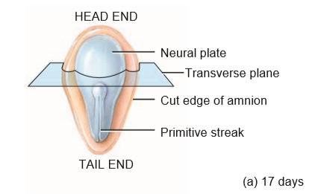
NEURULATION AND THE DEVELOPMENT OF SOMITES-DORSAL VIEWS

Slide 45
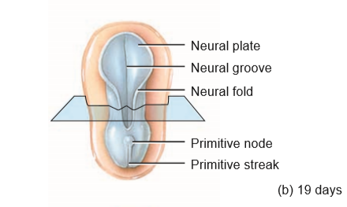
NEURULATION AND THE DEVELOPMENT OF SOMITES-DORSAL VIEWS

Slide 46
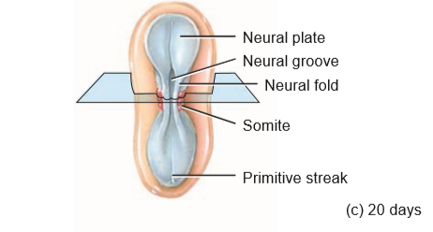
NEURULATION AND THE DEVELOPMENT OF SOMITES-DORSAL VIEWS.

Slide 47
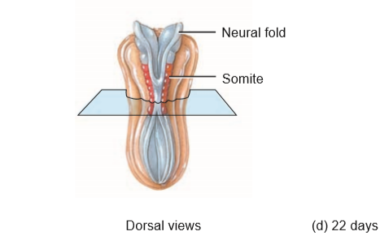
NEURULATION AND THE DEVELOPMENT OF SOMITES-DORSAL VIEWS.

Slide 48
NEURULATION
This occurs ﬁrst near the middle of the embryo and then progresses toward the head and tail ends.
Neuratube cells then develop into the brain and spinal cord.
The process by which the neural plate, neural folds, and neural tube form is called neurulation.
As the neural tube forms, some of the ectodermal cells from the tube migrate to form several layers of cells called the neural crest.

Slide 49
NEURULATION
Neural crest cells give rise to spinal and cranial nerves and their ganglia, autonomic nervous system ganglia, the meninges of the brain and spinal cord, the adrenal medullae, and several skeletal and muscular components of the head.
At about four weeks after fertilization, the head end of the neural tube develops into three enlarged areas called primary brain vesicles(forebrain),(midbrain) and (hindbrain)

Slide 50
NEURULATION
At about ﬁve weeks, the prosencephalon develops into secondary brain vesicles called the telencephalon and diencephalon.
The rhombencephalon develops into secondary brain vesicles called the metencephalon and myelencephalon.
The areas of the neural tube adjacent to the myelencephalon develop into the spinal cord.

Slide 51
CLINICAL CONNECTION
Neural tube defects (NTDs) are caused by arrest of the normal development and closure of the neural tube-spina biﬁda and anencephaly.
Anencephaly-the cranial bones fail to develop and certain parts of the brain remain in contact with amniotic ﬂuid and degenerate. Usually, a part of the brain that controls vital functions such as breathing and regulation of the heart is also affected.

Slide 52
CLINICAL CONNECTION
Infants with anencephaly are stillborn or die within a few days after birth.
The condition occurs about once in every 1000 births and is 2 to 4 times more common in female infants than males.

Slide 53
DEVELOPMENT OF SOMITES
By about the 17th day after fertilization, the mesoderm adjacent to the notochord and neural tube forms paired longitudinal columns of paraxial mesoderm.
The mesoderm lateral to the paraxial mesoderm forms paired cylindrical masses called intermediate mesoderm.

Slide 54
DEVELOPMENT OF SOMITES
The mesoderm lateral to the intermediate mesoderm consists of a pair of ﬂattened sheets called lateral plate mesoderm.
The paraxial mesoderm soon segments into a series of paired, cubeshaped structures called somites.
By the end of the ﬁfth week, 42–44 pairs of somites are present.

Slide 55
DEVELOPMENT OF SOMITES
The number of somites that develop over a given period can be correlated to the approximate age of the embryo.
Each somite differentiates into three regions: a myotome, a dermatome, and a sclerotome.

Slide 56
DEVELOPMENT OF SOMITES
The myotomes develop into the skeletal muscles of the neck, trunk, and limbs
The dermatomes form connective tissue, including the dermis of the skin.
Sclerotomes give rise to the vertebrae and ribs.

Slide 57
DEVELOPMENT OF THE INTRAEMBRYONIC COELOM
In the third week of development, small spaces appear in the lateral plate mesoderm.
These spaces soon merge to form a larger cavity called the intraembryonic coelom.
This cavity splits the lateral plate mesoderm into two parts called the splanchnic mesoderm and somatic mesoderm.

Slide 58
DEVELOPMENT OF THE INTRAEMBRYONIC COELOM
Splanchnic mesoderm forms the heart and the visceral layer of the serous pericardium, blood vessels, the smooth muscle and connective tissues of the respiratory and digestive organs, and the visceral layer of the serous membrane of the pleurae and peritoneum.

Slide 59
DEVELOPMENT OF THE INTRAEMBRYONIC COELOM
Somatic mesoderm gives rise to the bones, ligaments, and dermis of the limbs and the parietal layer of the serous membrane of the pericardium, pleurae, and peritoneum.

Slide 60
DEVELOPMENT OF THE CARDIOVASCULAR SYSTEM
Angiogenesis-This is the formation of blood vessels, begins in the extraembryonic mesoderm in the yolk sac, connecting stalk, and chorion in the 3rd wk.
This early development is necessary because there is insufﬁcient yolk in the yolk sac and ovum to provide adequate nutrition for the rapidly developing embryo.
Angiogenesis-mesodermal cells-into hemangioblasts- angioblasts-isolated masses of cells blood island.

Slide 61
DEVELOPMENT OF THE CARDIOVASCULAR SYSTEM
Spaces soon develop in the blood islands and form the lumens of blood vessels.
Some angioblasts arrange themselves around each space to form the endothelium and the tunics (layers) of the developing blood vessels.
As the blood islands grow and fuse, they soon form an extensive system of blood vessels throughout the embryo.

Slide 62
DEVELOPMENT OF THE CARDIOVASCULAR SYSTEM
About 3 weeks after fertilization, blood cells and blood plasma begin to develop outside the embryo from hemoangioblasts in the blood vessels in the walls of the yolk sac, allantois, and chorion.
These then develop into pluripotent stem cells that form blood cells.

Slide 63
DEVELOPMENT OF THE CARDIOVASCULAR SYSTEM.
Blood formation begins within the embryo at about the ﬁfth week in the liver and the twelfth week in the spleen, red bone marrow, and thymus.
The heart forms from splanchnic mesoderm in the head end of the embryo on days 18 and 19.
This region of mesodermal cells is called the cardiogenic area.

Slide 64
DEVELOPMENT OF THE CARDIOVASCULAR SYSTEM.
In response to induction signals from the underlying endoderm, these mesodermal cells form a pair of endocardial tubes.
The tubes then fuse to form a single primitive heart tube.
By the end of the third week, the primitive heart tube bends on itself, becomes S-shaped, and begins to beat.

Slide 65
DEVELOPMENT OF THE CARDIOVASCULAR SYSTEM.
It then joins blood vessels in other parts of the embryo, connecting stalk, chorion, and yolk sac to form a primitive cardiovascular system.

Slide 66
DEVELOPMENT OF THE CHORIONIC VILLI AND PLACENTA
As the embryonic tissue invades the uterine wall, maternal uterine vessels are eroded and maternal blood ﬁlls spaces, called lacunae, within the invading tissue.
By the end of the second week of development, chorionic villi begin to develop.

Slide 67
DEVELOPMENT OF THE CHORIONIC VILLI AND PLACENTA
These ﬁngerlike projections consist of chorion (syncytiotrophoblast surrounded by cytotrophoblast) that projects into the endometrial wall of the uterus.
By the end of the third week, blood capillaries develop in the chorionic villi.

Slide 68
DEVELOPMENT OF THE CHORIONIC VILLI AND PLACENTA
Blood vessels in the chorionic villi connect to the embryonic heart by way of the umbilical arteries and umbilical vein through the connecting (body) stalk, which will eventually become the umbilical cord.
The fetal blood capillaries within the chorionic villi project into the lacunae, which unite to form the intervillous spaces that bathe the chorionic villi with maternal blood.

Slide 69
DEVELOPMENT OF THE CHORIONIC VILLI AND PLACENTA
As a result, maternal and fetal blood vessels are in close proximity.
However,maternal and fetal blood vessels do not join, and the blood they carry does not normally mix.
Instead, oxygen and nutrients in the blood of the mother’s intervillous spaces, which are the spaces between chorionic villi, diffuse across the cell membranes into the capillaries of the villi.

Slide 70
DEVELOPMENT OF THE CHORIONIC VILLI AND PLACENTA
Waste products such as carbon dioxide diffuse in the opposite direction.
Placentation is the process of forming the placenta.
The placenta develops from two separate individuals, the mother and the fetus.
By the beginning of the twelfth week, the placenta has two distinct parts:

Slide 71
DEVELOPMENT OF THE CHORIONIC VILLI AND PLACENTA
(1).The fetal portion formed by the chorionic villi of the chorion and
(2).The maternal portion formed by the decidua basalis of the endometrium.
Functionally, the placenta allows oxygen and nutrients to diffuse from maternal blood into fetal blood while carbon dioxide and wastes diffuse from fetal blood into maternal blood.

Slide 72
DEVELOPMENT OF THE CHORIONIC VILLI AND PLACENTA
The placenta also is a protective barrier because most microorganisms cannot pass through it.
The placenta stores nutrients such as carbohydrates, proteins, calcium, and iron, which are released into fetal circulation as required.
The actual connection between the placenta and embryo, and later the fetus, is through the umbilical cord(which is 2 cm wide and about 50–60 cm length).

Slide 73
DEVELOPMENT OF THE CHORIONIC VILLI AND PLACENTA
The umbilical cord consists of two umbilical arteries, one umbilical vein, and supporting mucous connective tissue called Wharton’s jelly derived from the allantois.
A layer of amnion surrounds the entire umbilical cord and gives it a shiny appearance.
Pharmaceutical companies use human placentas as a source of hormones, drugs, and blood.

Slide 74
DEVELOPMENT OF THE CHORIONIC VILLI AND PLACENTA
Portions of placentas are also used for burn coverage.
The placental and umbilical cord veins can also be used in blood vessel grafts, and cord blood can be frozen to provide a future source of pluripotent stem cells.

Slide 75
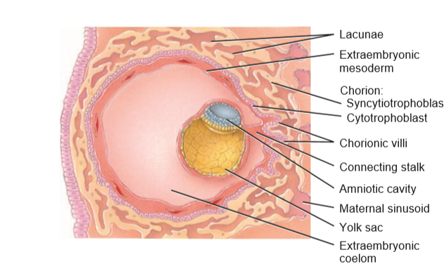
DEVELOPMENT OF CHORIONIC VILLI-FRONTAL SECTION THROUGH UTERUS SHOWING BLASTOCYST, ABOUT 13 DAYS AFTER FERTILIZATION

Slide 76
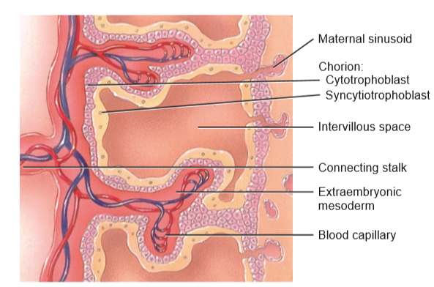
DEVELOPMENT OF CHORIONIC VILLI- DETAILS OF TWO CHORIONIC VILLI, ABOUT 21 DAYS AFTER FERTILIZATION.

Slide 77
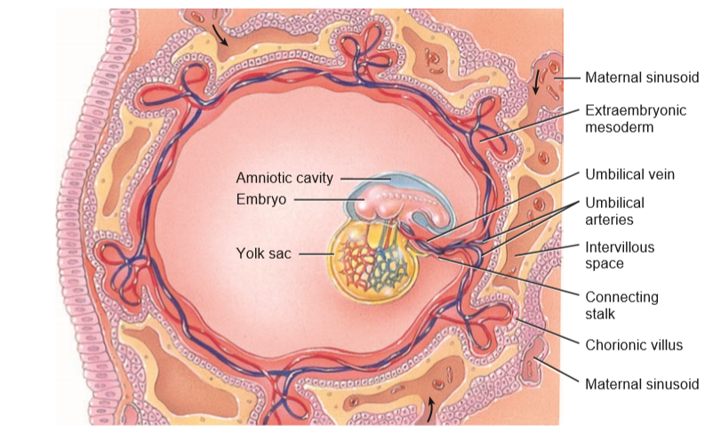
DEVELOPMENT OF CHORIONIC VILLI.

Slide 78
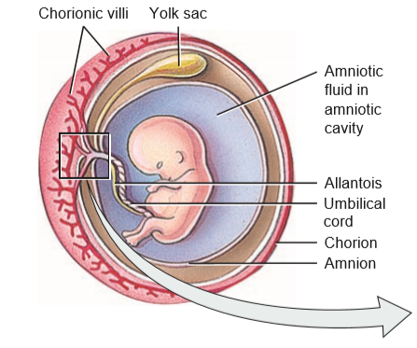
PLACENTA AND UMBILICAL CORD.

Slide 79
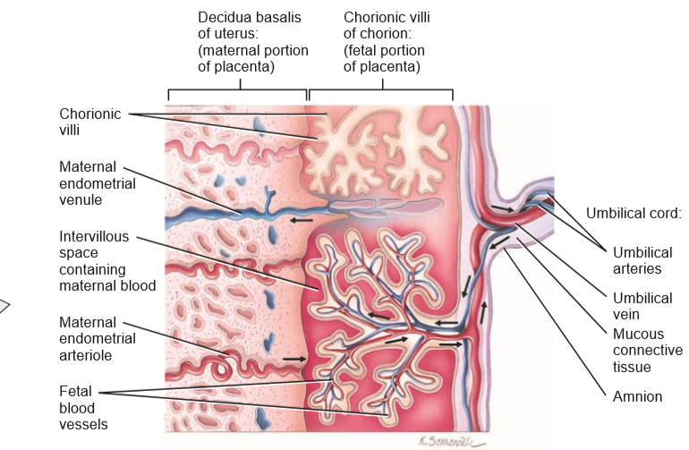
PLACENTA AND UMBILICAL CORD- DETAILS OF PLACENTA AND UMBILICAL CORD

Slide 80
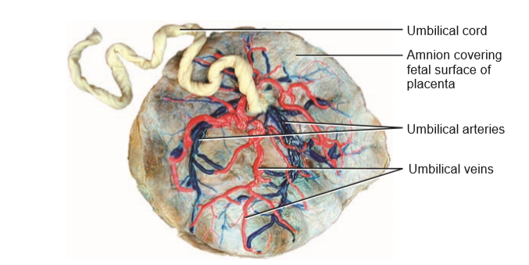
PLACENTA AND UMBILICAL CORD- FETAL ASPECT OF PLACENTA.

Slide 81
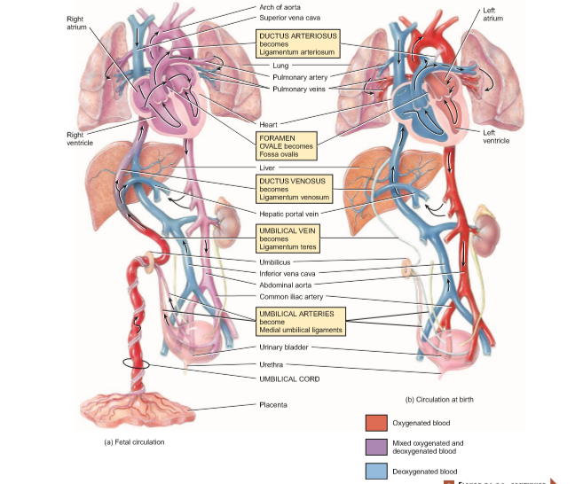
FOETAL CIRCULATION

Slide 82
CLINICAL CONNECTION
Placenta previa-placenta or part of it may become implanted in the inferior portion of the uterus, near or covering the internal os of the cervix.
Occurs in approximately 1 in 250 live births.
It is dangerous to the fetus because it may cause premature birth and intrauterine hypoxia due to maternal bleeding.

Slide 83
CLINICAL CONNECTION
1.What is the significance of gastrulation?
2.How do the three primary germ layers form?
3.Why are they important?
4.What is the function of the notochord?
5.Describe how neurulation occurs. Why is it important?
6.What are the functions of somites?

Slide 84
CLINICAL CONNECTION
7.How does the cardiovascular system develop?
8.How does the placenta form, and what is its importance?

Slide 85
THE END
THANK YOU

